Slide 1


Capstone Project: Exploring Coffee Quality Data
By Vishnu

Slide 2

PROJECT OVERVIEW
This project analyzes CQI’s Arabica coffee quality dataset to uncover insights into coffee origins, processing methods, and sensory attributes.
It builds a structured data model with KPIs, DAX measures, and interactive Power BI dashboards.
The goal is to help identify quality trends, top-performing countries, and key factors driving coffee excellence.

Slide 3
Business Objective and Constraints :
The Coffee Quality Institute (CQI) is a non-profit organization that works to improve the quality and value of coffee worldwide. It was founded in 1996 and has its headquarters in California, USA.
The organization works with coffee growers, processors, roasters, and other stakeholders to improve Coffee quality standards, promote sustainability, and support the development of the specialty coffee industry.

Slide 4



Technical Stacks :
POWER BI
Microsoft Excel
Microsoft Power Point

Slide 5



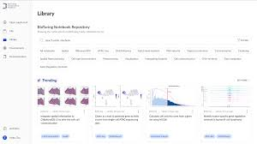

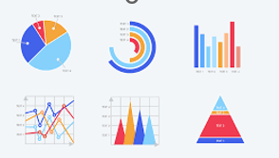


Project Architecture :
Business Understanding
Data Understanding
Data Collection
EDA
Publish
Data Visualization
Data Modelling
Data Preprocessing

Slide 6
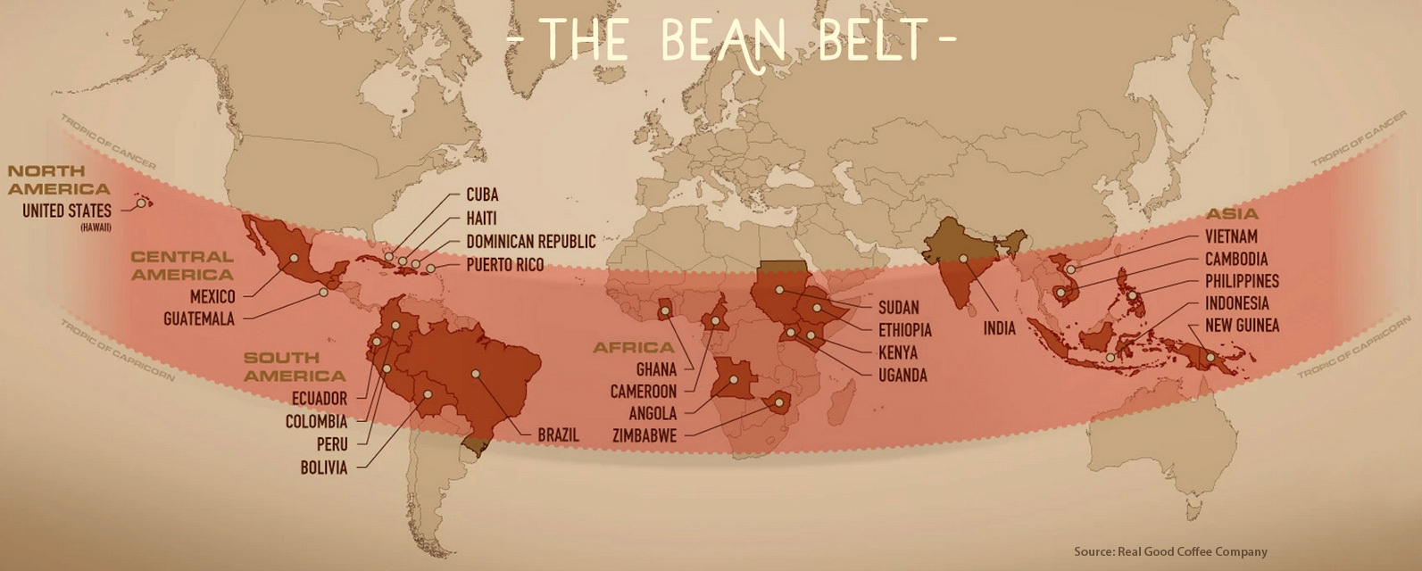
Map Showing Coffee Producing Regions across Globe

Slide 7
Table of Contents
01
EDA
04
Visulaization
02
Data Preprocessing
05
03
Data Modelling
Insights
06
Suggestions

Slide 8


Slide 9

☕ Coffee grows best in warm climates near the equator, an area often called the “coffee belt.”
🌍 The top coffee-producing countries include Brazil, Colombia, Ethiopia, Indonesia, and Vietnam.
🌱 Even though they are spread across three continents, they all share the same equatorial climate that is perfect for growing coffee.

Slide 10
Overview of the Dataset
The dataset covers 21 unique countries,21 unique region and 21 unique country partners across Globally.
The dataset contains 11 unique processing methods.
The dataset includes 40+ unique coffee varieties.
The dataset includes 8 distinct bean colors recorded during quality inspection.
Total Samples: 207 rows (each row = one unique coffee sample, identified by sample_id)
Total Attributes: 31 columns capturing sensory, physical, and categorical information.

Slide 11
Understand the Data
This dataset comes from CQI Arabica Coffee Quality Reports.
Each row represents a coffee sample evaluated by professional graders.
Key columns include:
Country of Origin, Region, Variety, Processing method, Colors , Status (descriptive details)
Grading date, Expiry date, Harvest year, Lot number, Partner , Altitude, Moisture (metadata)
Sensory Scores: aroma, flavor, acidity, body, aftertaste, balance, etc.
Number of bags, Bag weight
Total Cup Points (overall score, usually out of 100)
Defects: category 1 defects, category 2 defects, quakers (-ve quality indicators).
Keys: Country key , Processing key , variety key , color key , partner key

Slide 12
Category | Columns | Meaning
Identification | Sample Id ,Country key , processing key , variety key ,color key , partner key , Country, Region, Variety, Processing Method, Grading Date, Expiration Date , Harvest Year , Lot Number , color , Status | Basic details about where and how the coffee was grown and processed.
Sensory Attributes | Aroma, Flavor, Aftertaste, Acidity, Body, Balance, Uniformity, Clean Cup, Sweetness , overall , Altitude , Moisture | Scores (0–10) given by expert graders describing taste, smell, and mouthfeel and in which range coffee has grown and at what moisture percentage
Quality Score | Total Cup Points | Overall score (out of 100) summarizing the coffee’s quality.
Defects | Category 1 Defects, Category 2 Defects, Quakers | Negative qualities (broken beans, bad taste, etc.) that reduce cup quality.

Slide 13
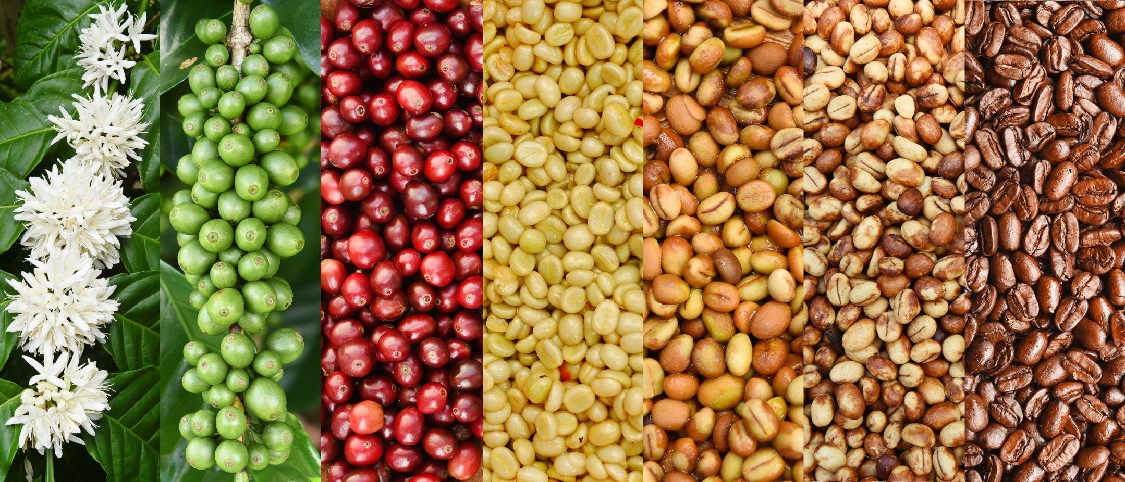
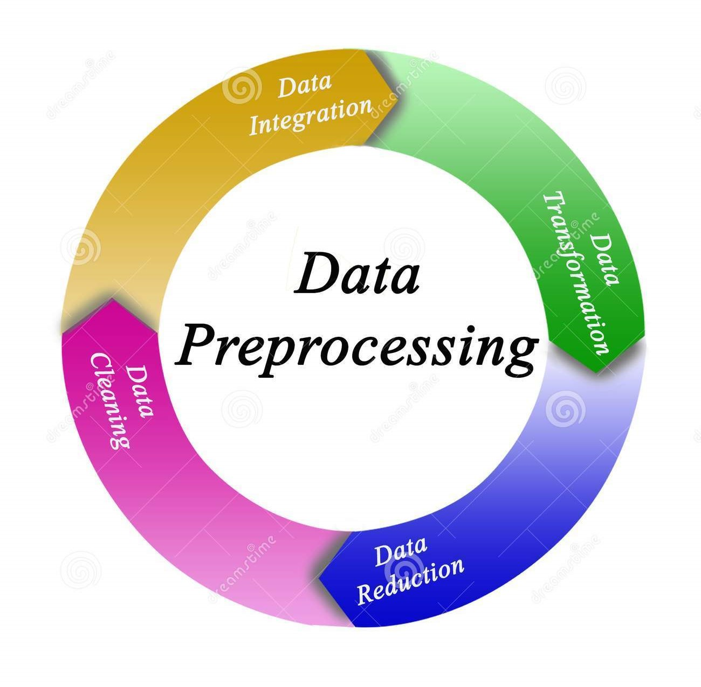

Slide 14
Data PreProcessing in Power Query Editor:
Column Names :
Standardized all column names to lowercase with underscores (e.g., Country of Origin → country_of_origin).
Reason: Ensures consistency and avoids issues during analysis or Power BI modelling .
ID :
Converted id column to text type to avoid accidental numeric treatment.
Lot Number :
Standardized values by trimming and capitalizing each word.
Corrected inconsistencies across countries and regions.
Replaced null values with “not_available”
Country of Origin & Region :
Removed extra non-English characters (e.g., 台灣咖啡研究室 → Taiwan Coffee Laboratory).
Reason: Ensures clean text for visualization and avoids encoding issues.
Trimmed spaces, cleaned text, and capitalized each word for uniformity.
Removed null and replaced it with not_available.
In Country Partner :
Trimmed and cleaned text.
Standardized by capitalizing each word for consistency.

Slide 15
Data PreProcessing in Power Query Editor:
Altitude :
Replaced invalid numeric entries like 4895 A 5650 and 1200~1600 with hypen(-).
Split mixed values (e.g., “1200-1400”) using delimiters and where there is low altitude and max altitude took average of it and then created a clean custom column.
Found Outliers and Null values removed from Altitude column and replaced them with median altitude.
Bag Weight :
Split values to remove the “kg” text, kept numeric only.
Outliers above 100kg were replaced with the standard industry bag weight (60kg).
Removed invalid or extreme values (like 19,200kg).
Final column retained clean and realistic bag weights.
Created custom column Total weight.
Harvest Year :
Splitted values by delimiter where multiple years existed.
Extracted only the Harvest Start Year to maintain consistency and removed end year because for some rows there is no end year
Grading Date:
Converted all values to lowercase for uniformity.
Cleaned suffixes (st, nd, rd, th).
Corrected spelling (e.g., “Augu” → “August”) and converted to proper date type.

Slide 16
Data PreProcessing in Power Query Editor:
Processing Method :
Simplified values (e.g., Washed / Wet → Washed).
Reason: The meaning of both words are same
Split text by delimiter / and removed secondary column (noise).
Renamed and standardized column names.
Replaced null values with Unknown for completeness.
Color :
Trimmed spaces, converted text to lowercase.
Standardized similar values:
“yellow green”, “yellow- green”, “yello-green” → yellow-green
“bluish-green” → blue-green
“brownish-green → brownish-green
Variety :
Trimmed, cleaned, and capitalized each word.
Replaced null and missing values with Unknown.
Status :
Standardized by trimming, cleaning, and capitalizing each word for consistency.
Total Cup Points :
Recalculated Total Cup Points based on sum of key sensory attributes (aroma, flavor, acidity, etc.).
Removed the old inconsistent column and kept the recomputed one for accuracy.

Slide 17

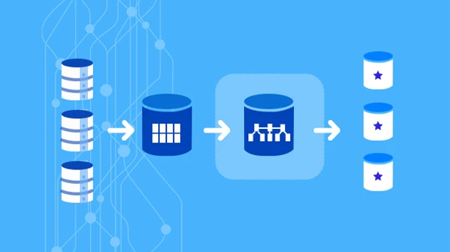
Data Modelling!

Slide 18
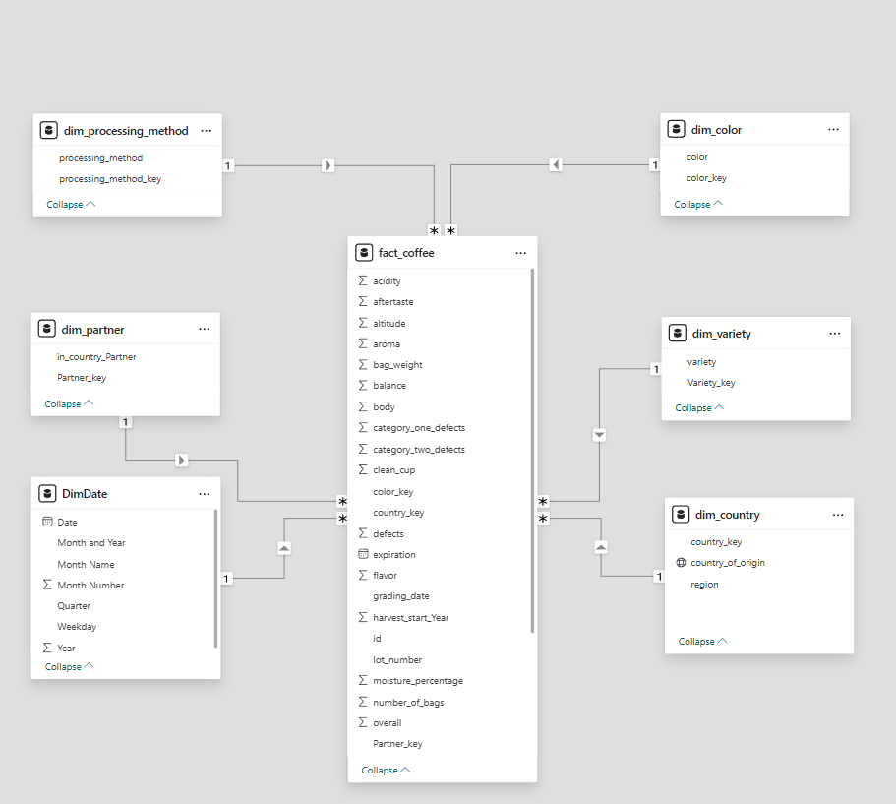
Why We Need a Data Model ?
From Raw Data to Usable Insights
Raw coffee data contained scores, defects, dates, and attributes mixed in one big table.
Directly analyzing raw data makes it hard to maintain, slow, and confusing.
Data modeling helps us:
Organize data into Fact and Dimension tables.
Improve performance and accuracy of reports.
Allow flexible slicing (by country, method,
partner,etc.).

Slide 19
Data Model Design
Star Schema for Coffee Quality Analysis
Fact Table: Fact Coffee
Holds measurable values (aroma, flavor ……, defects, total cup points, grading date , expiring date , altitude , moisture, harvest year and Keys from dim tables)
Dimension Tables:
Dim Country – country & region information.
Dim Processing Method – coffee processing types.
Dim Variety – coffee bean varieties.
Dim Date – built from grading date (trend & time analysis).
Dim Color – bean color classifications.
Dim Partner – partner details (labs, graders, organizations).

Slide 20
01
Visualization
Deep Analysis with Visulaization page by page

Slide 21
Executive summary
Our dataset covers 207 coffee samples with a total of 637 recorded defects.
The overall average cup score is 83.71 — good quality, but improvement potential exists.
The defect rate is high (65.7%), which significantly impacts quality and supply.
Moisture level averages at 10.74, which is within the acceptable range for coffee stability.
Top 5 countries by quality are Taiwan, Ethiopia, Gautamela, Tanzania, and Madagascar.

Slide 22
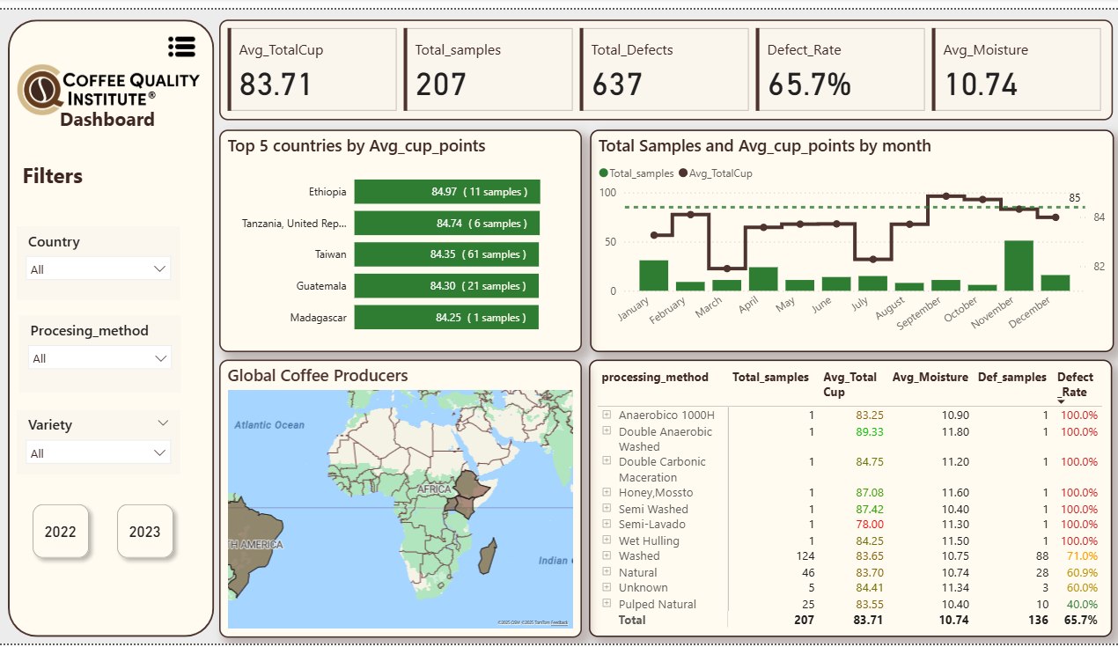

Slide 23
Sensory Attributes
Sensory quality was broken into 10 key attributes.
Clean Cup, Sweetness, and Uniformity scored almost perfect (10/10) — showing coffee has strong potential when well-processed.
Other attributes like Aroma (7.72), Flavor (7.74), Aftertaste (7.60) are slightly lower.
By altitude: Higher altitude correlates with better Avg Cup Scores (~85+).
Processing method analysis shows variation — Double Anaerobic, Semi Washed, Honey (Mossto) methods lead the quality.

Slide 24
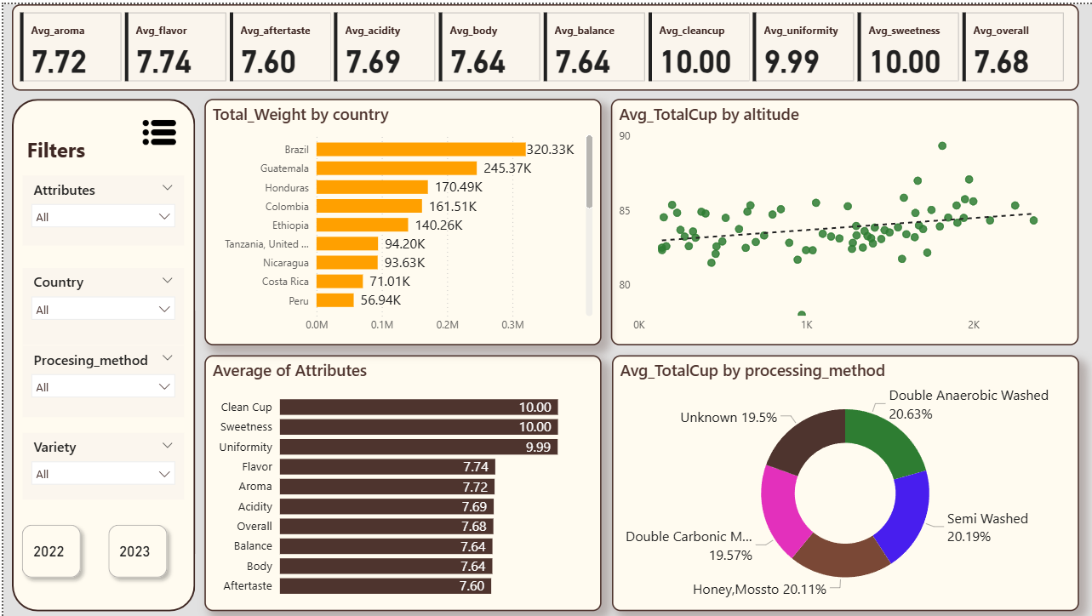

Slide 25
Origin and Defects Analysis
Out of 1.59M total coffee weight, 1.41M (88.74%) is defective, leaving only ~179K as usable.
Guatemala, Honduras, and Brazil contribute the highest defective weights.
Category-wise defects:
Category 1 defects: 28
Category 2 defects: 466
Quakers: 143
Defective weight % is extremely high in some regions (Ethiopia 100%, Myanmar 100%, etc.), highlighting major risks.

Slide 26
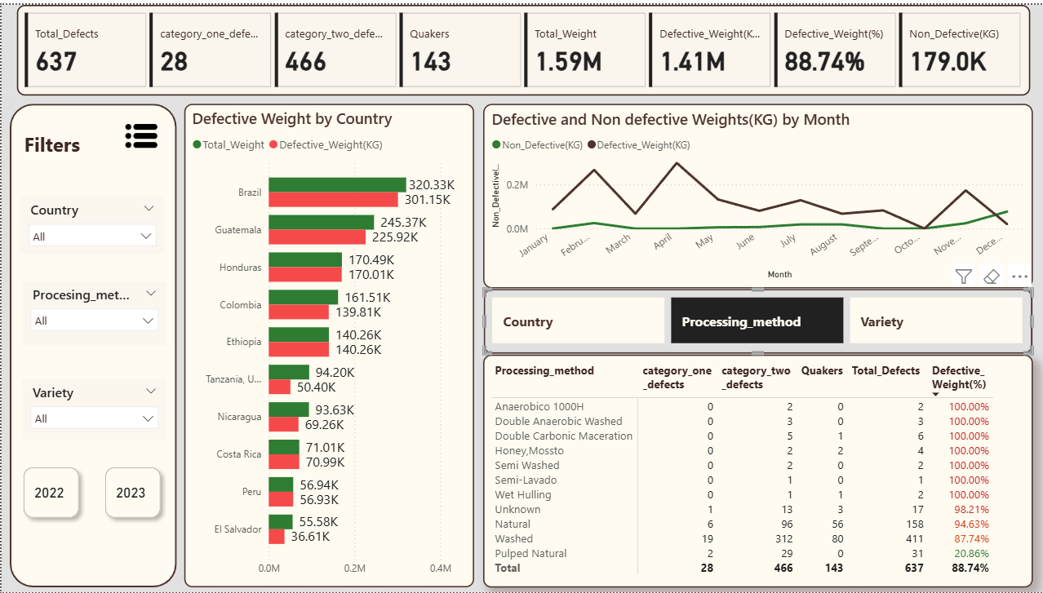

Slide 27
What-if Analysis
We modeled scenarios for altitude thresholds and defect reduction.
With adjustments, the What-If Avg Cup Score = 83.77 (slightly higher than baseline).
Altitude-adjusted Avg Score = 84.30, showing altitude is a critical factor.
Coffee saved (non-defective supply) = 423K kg.
Supply remaining after adjustments = ~42.3% of total.
This shows how targeted altitude sourcing + defect reduction can save supply while maintaining quality.”

Slide 28
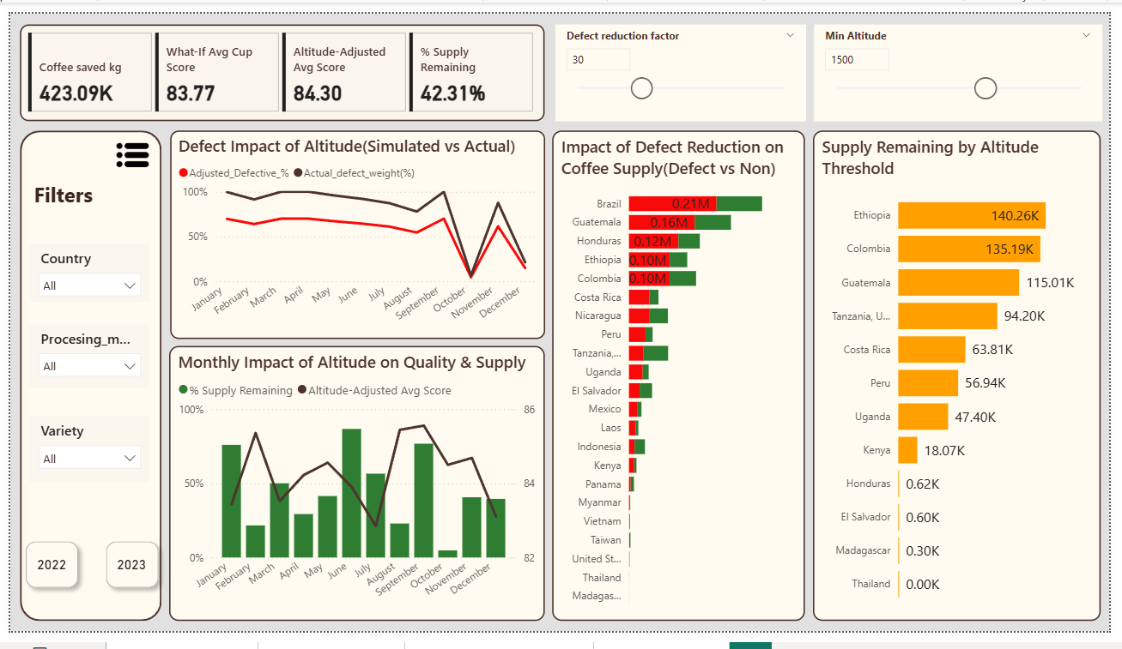

Slide 29
02
Insights
Outcome of Project

Slide 30
Insights:
What are the key determinants of coffee quality as evaluated through sensory attributes such as aroma, flavor, acidity, etc.?
- Aroma, flavor, Acidity, Body are the key attributes that impacts Coffee Quality much .
Castillo, Redbourn varieties are the top two Coffee Qualities.
Is there a correlation between processing methods, origin regions, and coffee quality scores?
The processing method impacts the coffee Bean attributes such as Acidity, Aroma, Body, Balance.
Regions in high Altitude produces Good Quality of Coffee Beans.

Slide 31
Insights:
Can we identify any trends or patterns in defect occurrences and their impact on overall coffee quality?
Category 2 defects are more compared to category 1 defects.
Washed and Natural processed beans has more defects.
November, April & March Graded Beans has more defects.
Harvest year 2021/2022 & 2022/2023 has more defected beans.

Slide 32
Insights:
How do different variables interact to influence the Total Cup Points, which represent an overall measure of coffee quality?
The Overall Cup points of a Coffee is influenced by attributes Acidity, flavor, Aroma, Body, Balance, After taste. The increase in this attributes enhances the Coffee Quality Points.
Beans Processed with Double Anaerobic washed, Semi washed & Honey/Mossto methods has high Cup Points.
Castillo, Red Bourbon & Sl34+Gesha are top 3 Quality Beans when compared to Cup Points.
Ethiopia, Tanzania, Taiwan, Gautemela, Madagasarcar are the top 5 Countries.

Slide 33
Insights:
Which sensory attributes scored the highest?
Clean Cup, Sweetness, and Uniformity consistently scored 10/10, showing that the coffees are free from major defects and retain sweetness.
Where is the room for improvement?
Aftertaste (7.60), Aroma (7.72), and Flavor (7.74) are slightly weaker compared to others, suggesting room for post-harvest and roasting improvements
Does altitude impact coffee quality?
Yes — higher altitude coffees scored around 85+, confirming altitude as a key driver of flavor and complexity.

Slide 34
Suggestions
Improve Coffee Quality via Defect Reduction
Insight link: 58%+ of 2022 coffee weight was defective.
Suggestion:
Invest in farmer training programs on harvesting & drying techniques.
Promote use of better sorting/grading equipment at cooperatives.
Build quality checkpoints at mills to identify and reject defective beans early.
Impact: Even a 10% defect reduction can save tens of thousands of kilos, improving both supply and farmer income.

Slide 35
Suggestions
Promote Best-Performing Processing Methods
Insight link: Double Anaerobic, Honey (Mossto), and Semi-Washed produced top scores.
Suggestion:
Provide technical support for adoption of these methods in regions still using traditional processes.
Develop case studies from high-scoring origins (e.g., Taiwan, Ethiopia) to encourage adoption.
Impact: Raises average cup scores without significantly reducing supply.

Slide 36
Suggestions
Focus on High-Altitude Sourcing
Insight link: Coffees grown above 1500m consistently scored higher (Avg 84.4 vs 83.9 baseline).
Suggestion:
Guide buyers to source from high-altitude regions where feasible.
Create “Altitude Grade” labels to promote premium pricing for high-quality coffees.
Impact: Differentiates CQI-certified coffees in specialty markets, improves perception of quality.

Slide 37
Suggestions
Origin-Based Strategies
Insight link: Some countries like Ethiopia & Indonesia show 100% defect rates in certain lots, while others (Taiwan, Costa Rica) consistently excel.
Suggestion:
For high-defect regions → target interventions (training, infrastructure, certification support).
For top-performing regions → build marketing campaigns around their quality success.
Impact: Tailors CQI support to maximize both quality improvement and brand reputation.

Slide 38

Live InteractiveProject Video

Slide 39

Thank You
Behind every successful analyst is a substantial amount of coffee.
By Vishnu

